Slide 1
Introduction to MATLAB for Engineers
Louise Brown
https://moodle.nottingham.ac.uk/course/view.php?id=150816

Slide 2
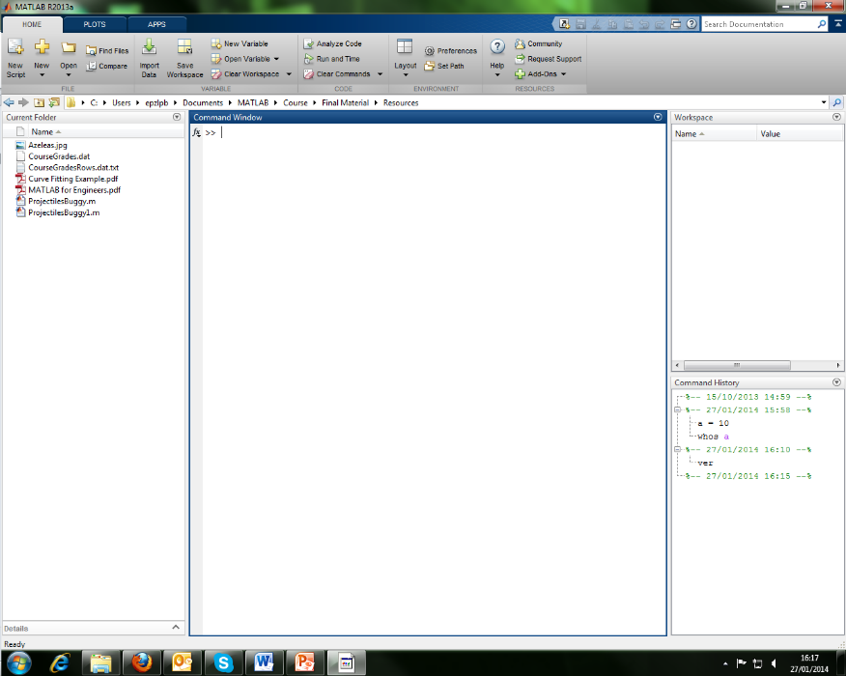
The MATLAB Desktop
Function browser
Workspace
window
Current folder
window
Command
window
Command
History
window
To change path use dialog given by Home->SetPath button or use
path(‘Folder’,path) or path(path,’Folder’)
Notes:
Run up matlab
Command window – interactive scratchpad
Maths & other expressions fx
Current folder – drop down menu above allow it to be changed – probably want to set to Z drive – show setting to Z drive
Load & save by default to/from this folder
Type path
path( ‘Folder’, path) or path(path,’Folder’) to add to path – eg if created library of functions in a given folder
Workspace window – shows all variables currently in memory for the matlab session
Command history – commands executed in both current and previous sessions
Start button – quick access to tools and toolboxes
File->Preferences.. - change font size

Slide 3
Changing the desktop configuration
At top right hand corner of window gives drop down menu with options:
Dock and undock windows
Slide window to tabbed position at side of window
Restore maximised window to tiled position
Stack windows by dragging the title bars over each other
Save setup: Desktop -> Save Layout.
Restore default layout: Desktop->Desktop Layout->Default
Notes:
Try
Might want different configurations for different computers, no of screens etc

Slide 4
Version Control
It’s all gone horribly wrong!
Does this look familiar?
TestCode.m
TestCode_data_set1.m
TestCode_data_set1_v2.m
TestCode_data_set1_v2_with_output.m
Use version control, eg Git, Subversion or Mercurial

Slide 5
Git Workflow
It’s all gone horribly wrong!
5
8
10
Discontinued branch
Branch
2
3
6
7
1
4
9
Trunk
T1
Tag
T2
Tags can correspond to code producing results for research papers

Slide 6
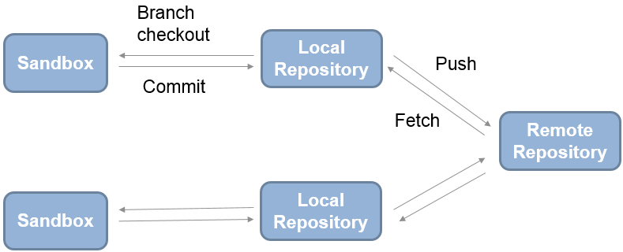
Git Workflow
GitHub

Slide 7
Fork Other Repositories
GitHub
Pull request
Fork
We can ‘fork’ to create a complete copy of another user’s repository in our own GitHub account.
‘Pull requests’ are used to request for our changes to be integrated into the original repository.
Another GitHub User’s Repository
Notes:
Show octocat example

Slide 8

Fork Course Code
First create a fork of the code in your own Github:
Go to louisepb/MatlabBasicCourseCode on GitHub
Select Fork (top right of page)
You should see a copy of the repo in your GitHub

Slide 9
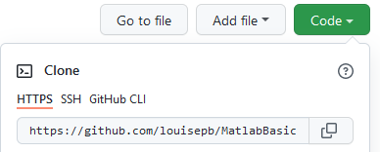
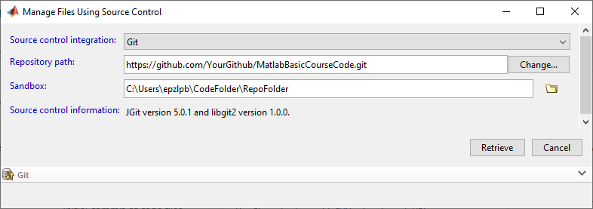
Clone Code to Local Drive
Then create a clone of the code on your local drive
Select the Code button and copy the address
Right click in Current Folder Window
Select Source Control -> Manage Files…
Run setupPath.m to add subfolders to path
Notes:
Run setupPath.m

Slide 10
Variables
All variables in MATLAB are stored as arrays
Scalar is 1x1 array
Vector is 1xn or nx1 array
Matrix is mxn array
…and so on for multi-dimensional arrays
Variables are created using an assignment statement
>> a = 10 creates a scalar variable
All variables are displayed in the workspace window
who – gives list of variable names
whos - gives name, size, type and memory size
Notes:
MATrix LABoratory
NB Don’t need to declare variable
Move to Matlab and show creating variable
Double click in workspace window to open variable editor
Show who and whos
Be aware all variables stay in workspace until cleared – clear
Clear var
Clc to clear command window
Variables default to double

Slide 11
Variable display format
Use format command to change display format
format long - fixed point format with 15 digits
format short – fixed point format with 4 digits
Note that format does not affect the way in which the variable is stored in memory
Type help datatypes to see other available data types
Notes:
Defaults to short
Type pi, then change to format long
Try typing help format
Can use classes given in datatypes to specify type or can use cast function

Slide 12
Variable Names
Must start with a letter but may include _ and numbers
Case sensitive
Certain reserved words cannot be used. Type iskeyword to see these
Built in function names may be used but this will block access to the original functions. (Clear workspace to restore)
Beware of overwriting pi, i and j
i and j are used as complex numbers by default
Type i or j at the command prompt
0 + 1.0000i
Notes:
Relate overwriting built in function names to path
A = sin(pi)
Sin = 2
A = sin(pi) - gives error because sin now defined as 1x1 array and pi isn’t valid index into it
Clear sin - clears sin from workspace so original definition now accessible
A = sin(pi) now works
If unsure of name use exist name to check not already in use
Use indices other than i or j if using complex numbers
Try creating string & variable

Slide 13
Saving Workspace Data
MATLAB format:
Variables in the workspace can be saved to a file using the Save Workspace button or by typing save <filename> at the command line
Using save(‘filename’, ‘var1’, ‘var2’,…) allows selected variables to be saved
Saves with .mat extension in format readable by MATLAB
Has advantage that it is operating system independent
ascii format:
Use a ‘-ascii’ parameter to save data in ascii format.
>> save('Data.dat','x','y', '-ascii')
Conventionally a .dat file extension is used
Notes:
Show save TestSave to .mat format
Clear workspace then double click or load
Advantage that operating system independent

Slide 14
Vectors
>> A = [1 2 3 4]
>> A = [1,2,3,4]
Both give 1x4 vector
A =
1 2 3 4
>> A = [1:4] Colon operator gives regularly spaced elements
Specify increment using format [first:step:last]
>> B = [1:2:9] gives B = 1 3 5 7 9
Increment can be decimal as well as integer
>> C = [1:0.2:2] gives
C =
1.0000 1.2000 1.4000 1.6000 1.8000 2.0000
Notes:
Create vectors using square brackets
Note colon operator step does not have to be integer
Show creating vectors and show in workspace

Slide 15
More Vectors
Create a vector with a given number of equispaced points using
linspace( start, end, number of elements)
>> vec = linspace( 1, 8, 5 )
vec = 1.0000 2.7500 4.5000 6.2500 8.0000
logspace can be used to create logarithmically spaced points
y = logspace(a,b,n) generates n points between decades 10ª and 10^{b}
>> vec = logspace(1,2,5)
vec =
10.0000 17.7828 31.6228 56.2341 100.0000
Notes:
Explanation that this is a function – difference between function parameters and separators in array
Also logspace

Slide 16
Character Vectors
Create character vectors using single quotes
charVec = ‘Here are some characters’
Stored as 1x24 char array
Type help strings for more information, or doc strings for full documentation
Notes:
Demonstrate character vector
Char stored as 2 bytes
Always use ‘help’ for quick documentation and ‘doc’ for full documentation

Slide 17
Column Vectors
Either semicolon operator
>> A = [1;2;3;4]
or transpose operator
>> A = [1:4]’
A =
1
2
3
4
can be used to create a column vector:
Notes:
Semicolon operator moves to a new row

Slide 18
Indexing Vectors
A = 1 3 5 7 9 11 13
A = 10 3 20 7 30 11 13
Subscript notation: A(3) gives 5
Subscript can be a vector: A([1 4 6]) gives 1 7 11
Colon notation to extract range: A(2:5) gives 3 5 7 9
Use ‘end’ either on its own or in range: A(4:end) gives 7 9 11 13
Replace element using index on left: A([1 3 5]) = [10 20 30]
Exercise 2.1 p.10
Notes:
Various ways of indexing into array..
Note index starts from 1
Vector subscript – result is a vector
Explanation/demonstration of assignment – show that the number of elements being replaced on the left must be the same as those supplied on the right
Lot of rules apply to matrices as well so if can grasp on vectors will make those easier
Exercise 2.1 p.10

Slide 19
Exercise 2.1
1) >> A = [5:2:17]
A =
5 7 9 11 13 15 17
2) >> B = [3:-1:-3]'
B =
3
2
1
0
-1
-2
-3
3) >> C = A([1 4 6])
C =
5 11 15
4) >> B([3 5 7]) = C
B =
3
2
5
0
11
-2
15

Slide 20
Arithmetic Operations
Addition a + b
Subtraction a – b
Multiplication a * b for matrix or scalar multiplication
a.*b for element by element multiplication
Division a / b for matrix or scalar division
a./b for element by element division
Left division a \ b for matrix or scalar left division
a.\b for element by element left division
Exponentiation a ^ b for matrix or scalar exponentiation
a.^b for element by element exponentiation
Notes:
Click 1: matrix and scalar multiplication
Click 2: element by element
Click 3: left division
Explain in more detail in next slides

Slide 21
Order of Precedence
Arithmetic operations will be carried out in the order:
Evaluate parentheses working from inside to outside
Exponential operations (^)
Multiplication (*) and division (/) from left to right
Addition (+) and subtraction (-) from left to right
Notes:
Example 2^2+3*4+5

Slide 22
Addition and Subtraction Operations
Scalar addition and subtraction performs the operation on each member of the vector or array:
>> A = [1:4]
A =
1 2 3 4
>> A = A + 10
A =
11 12 13 14
Note – this is achieved without using a loop
Array addition and subtraction is performed element by element
>> B = [5:8]
B =
5 6 7 8
>> A = A + B
A =
16 18 20 22
Notes:
Start to emphasise advantage of not having to use loops
Matlab interpreted language
Array operations optimised

Slide 23
Multiplication Based Operations
Multiplication ( and /,\,^) operate element by element on scalars in the same way as the addition operator.
>> A = [1:4]
A =
1 2 3 4
>> A = A * 10
A =
10 20 30 40
Notes:
Scalars – multiply, divide each element by number same as +-

Slide 24
Multiplication Based Operations
To multiply vectors or arrays element by element the ‘dot’ operators must be used. Note that vectors must be the same size.
>>A = [1:4]
A =
1 2 3 4
>> B = [2:5]
B =
2 3 4 5
>> D = A.*B
D =
2 6 12 20
Note that just using the * operator here will result in an error
Notes:
Scalars – multiply, divide each element by number same as +-
Normal matrix multiplication won’t work on these vectors

Slide 25
Multiplication Based Operators
Using multiplication based operators without a dot operator will result in standard matrix operations
So that
>> A*B
ans =
30
but
>> B*A
ans =
1 2 3 4
2 4 6 8
3 6 9 12
4 8 12 16
>> A = [1:4]
A =
1 2 3 4
>> B = [1:4]'
B =
1
2
3
4
Inner dimensions must match
1 x 4 * 4 x 1
Outer dimensions give final size
Notes:
Note that matrix multiplication is order dependent
Error – Inner matrix dimensions must agree

Slide 26
Vectors as Function Input
Vectors can be used as input arguments to functions – both built-in and user defined
>> A = [0:pi/6:pi]
A =
0 0.5236 1.0472 1.5708 2.0944 2.6180 3.1416
>> B = sin(A)
B =
0 0.5000 0.8660 1.0000 .8660 0.5000 0.0000
Exercise 2.2 p.13
Notes:
Exercise 2.2 p.13

Slide 27
Exercise 2.2
1) >> 1/(2+3^4) + 5/(6*7) + 7/8
ans =
1.0061
2) >> A = linspace( 0, 2*pi, 9 )
A =
0 0.7854 1.5708 2.3562 3.1416 3.9270 … 4.7124 5.4978 6.2832
>> SinAng = sin(A)
SinAng =
0 0.7071 1.0000 0.7071 0.0000 -0.7071 … -1.0000 -0.7071 -0.0000
3) >> SinAng = SinAng + 1
SinAng =
1.0000 1.7071 2.0000 1.7071 1.0000 0.2929 0 0.2929 1.0000

Slide 28
Exercise 2.2
4) >> B = [1:9]
B =
1 2 3 4 5 6 7 8 9
>> SinAng.*B
ans =
1.0000 3.4142 6.0000 6.8284 5.0000 1.7574 0 2.3431 9.0000

Slide 29
Left Division
a\b = a⁻¹b for matrix operations
a.\b = b/a when performed element by element on arrays or when one of the operands is a scalar
>> A = [1:4]
A =
1 2 3 4
>> A.\2
ans =
2.0000 1.0000 0.6667 0.5000
Notes:
Left division has two definitions:
When would you use a.\b?

Slide 30
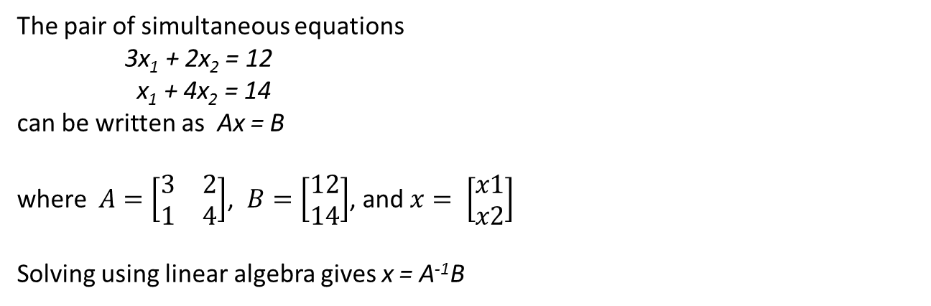
Using Left Division to Solve Simultaneous Equations
The pair of simultaneous equations
3x₁ + 2x₂ = 12
x₁ + 4x₂ = 14
can be written as Ax = B
where $A=\left[\begin{matrix}3 & 2 \\ 1 & 4\end{matrix}\right]$, $B=\left[\begin{matrix}12 \\ 14\end{matrix}\right]$, and $x= \left[\begin{matrix}x1 \\ x2\end{matrix}\right]$
Solving using linear algebra gives x = A⁻¹B
In MATLAB set up the arrays
>> A = [3 2; 1 4]
A =
3 2
1 4
>> B = [12;14]
B =
12
14
and solve using the left division operator
>> x = A\B
x =
2
3
Notes:
Next slide will cover setting up matrices
Going to do an example but will just cover creating matrix first

Slide 31
Matrices
Use the semicolon operator to separate the rows of a matrix
>> A = [1 2 3 4 5; 5 6 7 8 9]
A =
1 2 3 4 5
5 6 7 8 9
The colon operator can be used as for vectors.
The same result is given by
>> A = [1:5;5:9]
Exercise 2.3 p.14
Notes:
Think of matrix as a stack of row vectors
Must have same number of elements in each row
Now have a go at solving simultaneous equations with Exercise 2.3 p.14

Slide 32
Exercise 2.3
>> A = [1 2 3; 2 3 -1; 4 -1 2]
A =
1 2 3
2 3 -1
4 -1 2
>> B = [13;4;13]
B =
13
4
13
>> X = A\B
X =
2.0000
1.0000
3.0000

Slide 33
Character Matrices
Arrays of characters must have the same number of elements in each row.
O | N | E
S | E | V | E | N
F | I | V | E
>> charArray = [‘ONE';‘SEVEN';‘FIVE']
Error using vertcat
Dimensions of matrices being concatenated are not consistent.
Notes:
Note can create arrays of strings if all same length
Will come back to more straightforward way of storing different length strings later

Slide 34
Character Matrices
Use char function to create arrays with padded strings
>> charArray = char('one','seven','five')
charArray =
one
seven
five
Creates 3x5 char array with spaces padding shorter strings
O | N | E
S | E | V | E | N
F | I | V | E

Slide 35
String Scalars
Used to store a group of characters as a string type
>> str = “one”
str =
“one”
>> strArray = [“one”; “seven”; “five”]
strArray =
3x1 string array
“one”
“seven”
“five”
Addition operator can be used to concatenate strings:
>> str = “one” + “ seven” + “ five”
str =
“one seven five”
Notes:
Show difference between “one” and ‘one’

Slide 36
Indexing String Scalars
To access the string:
>> strArray(2)
ans = “seven”
To access the char vector:
>> strArray{2}
ans = ‘seven’
>> strArray{2}(3)
ans = ‘v’

Slide 37
Matrix Indexing
A = 1 2 3 4 5
5 6 7 8 9
9 10 11 12 13
row
column
Subscript notation: A(3,2) = 10
Colon notation to extract range in both rows and columns: A(2:3, 3:4) = 7 8
11 12
Colon notation to extract whole row or column: A(2, : ) = 5 6 7 8 9
Or several rows or columns: A( : , [1 3 5]) = 1 3 5
5 7 9
9 11 13
Notes:
Use subscript notation as for vectors with row, column specification
Think of : on its own as ‘all rows’ or ‘all columns
Ask how would extract some examples?
How would you extract scattered elements? -> linear indexing

Slide 38
Linear Indexing (1)
A = 1 1 2 4 3 7 4 10 5 13
5 2 6 5 7 8 8 11 9 14
9 3 10 6 11 9 12 12 13 15
Linear index is obtained by counting down each column in turn
Linear index: A(5) = 6

Slide 39
Linear Indexing (2)
A = 1 1 2 4 3 7 4 10 5 13
5 2 6 5 7 8 8 11 9 14
9 3 10 6 11 9 12 12 13 15
Find indices for elements (1, 3) and (2, 4)
Use sub2ind( size, row vector, column vector )to convert from subscript to linear index
(1, 3) and (2, 4)
Row vector [1 2] Column vector [3 4]
>> Index = sub2ind( size(A), [1 2], [3 4] )
Index =
7 11
Then extract actual elements using the linear index vector: A(Index) = 3 8
Notes:
Needed if want to extract scattered elements of matrix
Size(A) returns the number of rows and columns
index = sub2ind(size(A), [1 2], [3,4])
Show A(index) = A(index)+0.1

Slide 40
Combining Matrices
Larger arrays can be built up from smaller ones:
>> A = [1:5;5:9]
A =
1 2 3 4 5
5 6 7 8 9
>> B = [1:2:9;2:2:10]
B =
1 3 5 7 9
2 4 6 8 10
>> D = [A;B]
D =
1 2 3 4 5
5 6 7 8 9
1 3 5 7 9
2 4 6 8 10
>> E = [A B]
E =
1 2 3 4 5 1 3 5 7 9
5 6 7 8 9 2 4 6 8 10
Note that the dimensions of arrays being joined must be consistent.
Notes:
Effectively same as the way that vectors are stacked to make matrices
Could also have put side by side: [A B]

Slide 41
Matrix Functions
A = 1 2 3 4 5
5 6 7 8 9
length(X) returns the largest dimension of an array: length(A) = 5
size(X) returns a vector containing the length of each dimension of the array: >> dims = size(A)
dims =
2 5
The rows and columns can also be returned as separate variables:
>> [row,column] = size(A)
row =
2
column =
5
Notes:
Take a look at some useful matrix functions:
If use [row,column] = size(A) can get separate variables for row & column – demonstrate?
Same result for vector if returning single argument

Slide 42
Useful automatically generated matrices
Identity matrix: eye(X)
>> eye(2)
ans =
1 0
0 1
Only one parameter as the identity matrix is square
p… for matrices of more than two dimensions
All ones: ones(m, n, p…)
>> ones(2,3)
ans =
1 1 1
1 1 1
All zeros: zeros(m, n, p…)
>> zeros(3,2)
ans =
0 0
0 0
0 0
Notes:
Note identity matrix only one parameter as must be square
Note the p dimension as can have more than 2D matrices

Slide 43
Matrix Memory Management
Extra elements may be added to an array simply by allocating an element at a given position
A = 1 2
3 4
Adding an element at (5,5) grows the array:
>> A(5,5) = 10
A =
1 2 0 0 0
3 4 0 0 0
0 0 0 0 0
0 0 0 0 0
0 0 0 0 10
A new block of memory will be allocated each time extra elements are added to the array – this is slow!
If the final size of the array is known create an array of the final size (typically using the zeros() function) and then assign elements as required
Notes:
Need to be careful how matrices are specified
If have array A…and add element (5,5) will grow array and reallocate memory
If have loop which adds one element each time will do the same
Copy is made of data in order to move. If have v large data set may have problems -> 2 copies in memory during copy operation
Can then use sparse array in functions as normal

Slide 44
Sparse Arrays
For arrays with large numbers of zero elements the sparse(N) function can be used to squeeze out zero values.
A =
1 2 0 0 0
3 4 0 0 0
0 0 0 0 0
0 0 0 0 0
0 0 0 0 10
sparse(A) reduces the size of A from 200 to 84 bytes
Exercise 2.4 p.19
Notes:
Demonstrate
Exercise 2.4 p.19

Slide 45
Exercise 2.4
1) >> A = [9 12 13 0;10 3 1 5;2 5 10 3]
A =
9 12 13 0
10 3 1 5
2 5 10 3
>> B = [1 4 2 11;9 8 16 7;12 5 0 3]
B =
1 4 2 11
9 8 16 7
12 5 0 3
2) >> C = A(3,3)
C =
10
>> D = A(:,3)
D =
13
1
10
>> E = [B(1,:);B(3,:)]
E =
1 4 2 11
12 5 0 3
>> F = [A;B]
F =
9 12 13 0
10 3 1 5
2 5 10 3
1 4 2 11
9 8 16 7
12 5 0 3
>> G = [A(:,1) B(:,4)]
G =
9 11
10 7
2 3

Slide 46
Exercise 2.4
3) >> E(2,2) = 20
E =
1 4 2 11
12 20 0 3
>> A(1,:) = 0
A =
0 0 0 0
10 3 1 5
2 5 10 3
>> F(:,3) = 1:6
F =
9 12 1 0
10 3 2 5
2 5 3 3
1 4 4 11
9 8 5 7
12 5 6 3
>> A(:,1) = B(:,2)
A =
4 0 0 0
8 3 1 5
5 5 10 3

Slide 47
Scripts
Script files are created by selecting New Script or typing ‘edit’ at the command prompt.
MATLAB script files are saved with a ‘.m’ extension (by default to the current folder)
Scripts are run by typing the script name at the command prompt
Comment lines start with %
The first comment line in a script is the H1 line which is used as a help for the script.
A semicolon at the end of the line will suppress output to the monitor
Notes:
Emphasise everything done so far been in workspace - transient
Show creating script ( ScriptExample.m)
% Test script to calculate square roots
% Second H1 line
% Script body
A = [1:10];
A = sqrt(A); %Type squr[A] – gives error for bracket but not squr until run
Show help
Show running from command prompt
NB no output as used semicolons
*Recap what actually done:
Created script in file ScriptExample.m
Run, correcting errors
Show, saved in current folder
Emphasise if asked to create script that need to create in editor and save

Slide 48
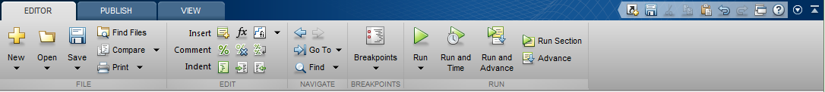
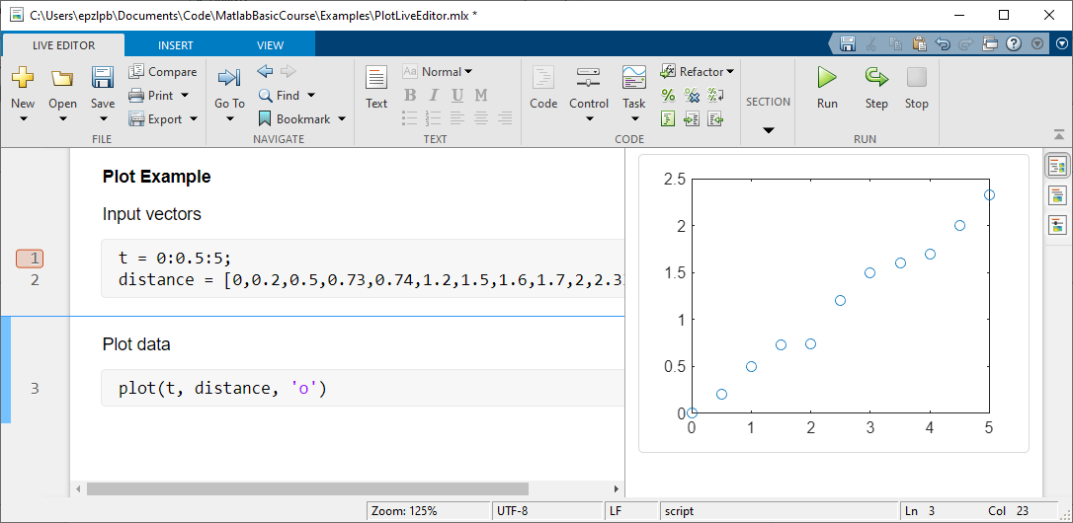
Code Sections and Live Editor
Insert section break
Run section options
Select how output is displayed
Notes:
Copy .m script text and create new live script with text.
Show different display options.
Right click to get clear output options

Slide 49
Simple User Input
Use input(str) command to fetch user input
>> value = input( ‘Enter a value: ‘);
Enter a value:
10
User input
A second parameter ‘s’ indicates the input is a character or string.
>> str = input('Input yes or no ','s')
Input yes or no yes
str =
yes
Notes:
Change square root script to input max value
maxVal = input('Input max value ');

Slide 50
Output
Use the disp(str) function for simple output
To display a variable use disp(A)
Or to output a string:
% Create a string
str = 'Output from disp function‘;
% Pass the string as a parameter to the disp function
disp( str );
>> Output from disp function

Slide 51
Output
Simple strings can be assembled to give output data.
Use the num2str function to convert numerical data into a string
>> Vel = 20;
>> strTitle = ['Starting speed = ' num2str(Vel) ' m/s'];
>> disp(strTitle);
Starting speed = 20 m/s
Or using string scalars:
>> strTitle = “Starting speed “ + num2str(Vel) + “ m/s”
Notes:
Str = [‘The ‘ num2str(maxVal) ‘values of root A are: ‘ num2str(A)];
Or str = “The “ + num2str(maxVal) + “values of root A are: “ + num2str(A);
Add disp(str) to script example

Slide 52
Freefall Script
Write a script called FreeFallExample.m which calculates the distance travelled by a freely falling object at ten time increments from release to time, t, using the equation
d = 0.5gt²
The time will be user input.
Output the distances calculated.
Notes:
Preparation for Exercise 4.1
t = 0 to t=input time at time increment t/10

Slide 53
Freefall Script
Notes:
Introduce idea of code planning/design
Get them to write down the steps involved in the example
Get into pairs to plan pseudocode?
Flowcharts
Pseudocode

Slide 54
Exercise 4.1
Write a script called FreeFall.m which calculates the distance travelled by a freely falling object at each time increment between two given times using the equation
d = 0.5gt²
The start and end times and time increment will be user input.
Output the distances calculated.
(For more of a challenge present the output as two columns showing times and distances)
Exercise 4.1 p24
Notes:
Exercise 4.1 p22

Slide 55
Exercise 4.1

Slide 56
Exercise 4.1
Input start time, end time, time increment and g
Create vector of times
Calculate distance for each time
Output times and distances

Slide 57
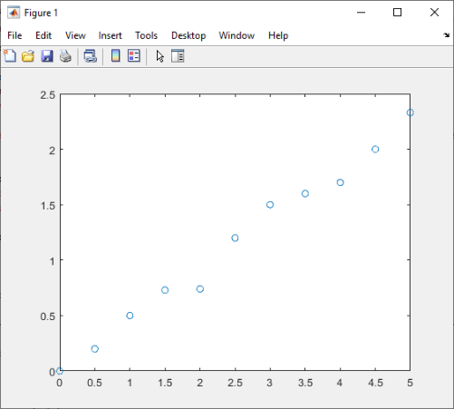
Simple x-y plots
plot(x,y) plots vector x against vector y
>> t = 0:0.5:5
>> distance = [0, 0.2, 0.5, 0.73, 0.74, 1.2,… 1.5, 1.6, 1.7, 2.0, 2.33]
>> plot(t, distance, ‘o’)
Third parameter used to specify line style, marker type and colour
plot command automatically fits axes to the data.
To control axis scaling use: axis( [xmin, xmax, ymin, ymax])
Notes:
Matlab really good for plotting data
x = linspace(-pi,pi,20)
points = sin(x)
plot(x,points,'o') and from workspace
Show if only use plot( sin(x) ) just plots against integer range
Point out different sorts of plot available

Slide 58
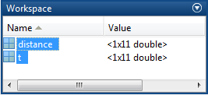
Plot from Workspace
Select variables to plot
Select plot type from ribbon
Exercise 5.1 p24
Notes:
Exercise 5.1 p24

Slide 59
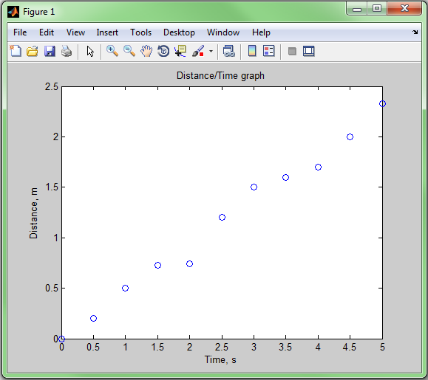
Annotating Figures
From the script:
>> xlabel( ‘Time, s’)
>> ylabel(‘Distance, m’)
>> title(‘Distance/Time graph’)
Note – plot command must be executed first
Or using Property Inspector:
Use Open Property Inspector icon
Or type ‘inspect’ at the command prompt
Script for similar plots can be created using File->Generate code
Notes:
Xlable(‘Time, s’)
Ylable(‘Distance, m’)
Title(‘Distance/Time graph)
Show plot tools on figure previously created – basically make aware that it’s there and they can investigate later
Show file->generate code
Cut and paste into live editor and show how adds the code for titles etc.

Slide 60
Plotting Multiple Data Sets
Various methods of plotting multiple data sets on one figure:
hold on - any plot commands will plot on same figure until hold off is executed
Send multiple sets of data in one plot command
>> plot( t, distance, ‘s’, t, distance2, ‘o’ )
Collect multiple sets of data into one matrix
>> distances = [distance;distance2]
>> plot( t, distances, ‘o’ )
Creating multiple figures:
Select the current figure to be plotted to using the figure(n) command. Any subsequent plots will be performed on this figure

Slide 61
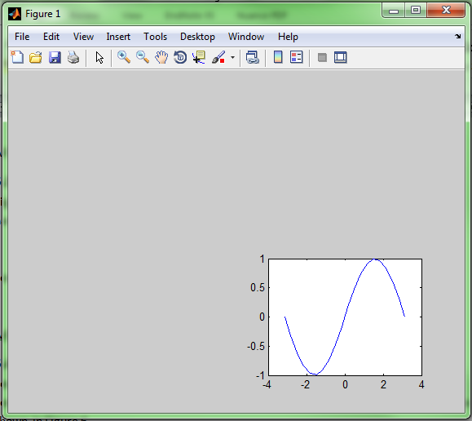
Subplots
Several plots in the same window
Use subplot(m,n,p) command.
Window is split into grid of m rows by n columns .
p selects the window for plotting.
>> subplot(2,2,4)
% Call plot commands before calling subplot again for next location
p = 1 | p = 2
p = 3 | p = 4
Notes:
Note that subwindows are numbered row by row rather than down columns like arrays

Slide 62
Saving Figures
Save figures using saveas function:
saveas(gcf, ‘filename’, ‘format’)
returns the handle to the current figure
>> saveas( gcf, ‘Figure’,‘png’)
Saves to Figure.png
File->Save Saves a Matlab .fig file
File->Save As… Saves to standard image formats

Slide 63
Exercise 5.2
Suggested initial values:
Start velocity = 60 m/s
Launch angle = pi/3
Plot horizontal distance on x-axis and vertical distance on y-axis
Format the title (to include the velocity and angle) using a vector of strings
Remember to convert the angle back into degrees to display in the title
Use num2str to create strings from variables to include in the string,
eg ‘30 degrees’
Exercise 5.2 p29
Notes:
Exercise 5.2 p27
Don’t need user input – just specify values
Few things in here that you don’t know – make use of help/doc/web search
Plan before you start
*Show use of num2str + using help/function browser to find functions

Slide 64
Debugging
3 types of errors: syntax, runtime and logical
Syntax errors:
At the command line an error message is displayed
In the edit window: orange bar – warning
red bar - error
Runtime errors:
Occur as code executes, eg out of bounds index
Within a script an error message is given including the line number
Note that in MATLAB divide by 0 does not generate an error – a value of Inf is assigned and the program continues to run
Logical errors:
Hardest to find. Program runs but gives incorrect results
In MATLAB can use Code Cells or the built-in debugger
Notes:
disp('syntax error)
for k = 1:4
a(k) = a(k)+1
end

Slide 65
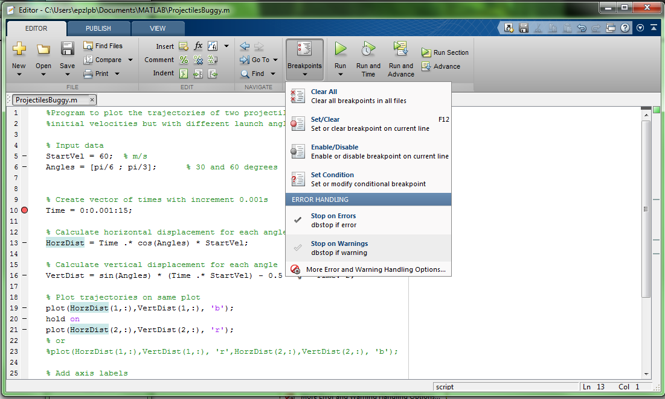


Using the Built-in Debugger
Set/clear breakpoint (F12)
Save and run (F5)
Breakpoint
Right click on breakpoint to display options
When running debug the menu is displayed:
Step into (F11)
Continue (F5)
Exit debug mode (Shift + F5)
Step (F10)
Step out (Shift + F11)
Notes:
Demonstrate debugger
Exercise 6.1 p.30

Slide 66
Program Structure
Sequential
Selection
Repetition
Input
Input
Input
true
Decision
false
true
Decision
false
Calculation
Calc
Calc
Calc
Output
Notes:
So far only used sequential operations. Normally programs more complex.
Look first at Selection. Need some means of making decisions.

Slide 67
Relational and Logical Operators
Logical data type: a = true or a = false – occupies 1 byte
convert to logical using b = logical(x)
Relational a < b less than
a <= b less than or equal to
a > b greater than
a >= b greater than or equal to
a == b equal to
a ~= b not equal to
Logical a & b and
a | b or
~ a not
xor( a,b ) exclusive or
Notes:
B = logical(x) – gives true for any value other than 0
& on arrays
&& only on scalars and short circuits

Slide 68
Comparing Matrices
Comparisons on matrices will compare corresponding elements and create a matrix of the results using the logical data type
>> a = 1:5
a =
1 2 3 4 5
>> b = [3 1 2 4 0]
b =
3 1 2 4 0
>> c = a > b
c =
0 1 1 0 1

Slide 69
Logical Indexing
Relational and logical operators are performed element-wise on vectors or matrices resulting in a logical matrix:
A = 1 2 3 4 5
3 4 5 6 7
>> B = A > 2 & A < 6
B = 0 0 1 1 1
1 1 1 0 0
Note that for compound tests each test is written out in full: A>2 and A<6
Can’t use 2 < A < 6 type format
Logical matrix B can be used as a mask to perform operations on selected elements of a matrix
>> A(B) = sqrt(A(B))
A = 1.0000 2.0000 1.7321 2.0000 2.2361
1.7321 2.0000 2.2361 6.0000 7.0000
Notes:
Again no need to use loop to perform operation on elements which satisfy condition
Break into steps: Create B, A(B), A(B) = 10*ans

Slide 70
Logical Indexing(2)
B = 0 0 1 1 1
1 1 1 0 0
A = 1 2 3 4 5
3 4 5 6 7
Extract the elements which satisfy the test: >> C = A(B)
C =
3
4
3
5
4
5
To find the indices of the elements which satisfy the test use the find() function
>> D = find(A>2 & A<6)
D =
2
4
5
6
7
9
Notes:
Test a>2 & a<6
Extract the elements which satisfy the condition
Find() function returns the indices

Slide 71
find()
Index = find(x,1) – returns the linear index of the first nonzero element, or first element which satisfies a specified condition
>> B = [0 0 0 3 4 5 6]
B =
0 0 0 3 4 5 6
>> find( B,1 )
ans =
4
>> find( B>4, 1)
ans =
6
Notes:
Find: Example of temperatures and want to find first that’s above certain value

Slide 72
Floating Point Comparisons
Comparison of floats or doubles
Small differences resulting from floating point arithmetic may cause errors when checking for equality.
>> a = 0.5-0.4-0.1
a =
-2.775557561562891e-17
Use a tolerance check:
>> abs(a) < 1e-8 % Choose appropriate tolerance
ans =
logical
1
FloatingPoints.m (Cells 1&2)
Notes:
Comparison of doubles – eg 1.0 may actually be 0.9999999 so ==1.0 no good

Slide 73
Floating Point Comparisons (2)
Comparison of floats or doubles
Small differences resulting from floating point arithmetic may cause errors when checking for equality.
A
9.999999999999998e-01
if ( A == 1) % will be false
Tol = 1e-6;
abs( A – 1.0 ) < Tol % will return true
The value should be 1
Calculate the difference between the actual value and the one being tested for
FloatingPoints.m (Cells 3&4)
Notes:
Exercise 8.1 p35

Slide 74
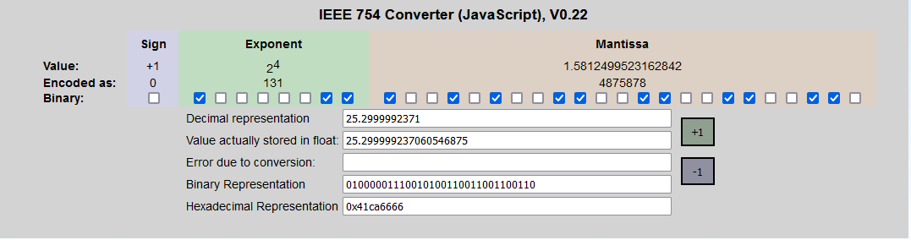
Floating Point Numbers
https://www.h-schmidt.net/FloatConverter/IEEE754.html

Slide 75
Exercise 8.1
3) >> find(A>100)
ans =
4
9
4) >> B = A(A>100)
B =
144
196
1) >> A = [9 12 18 0;10 3 1 7;2 5 14 22]
A =
9 12 18 0
10 3 1 7
2 5 14 22
>> B = A >=7 & A < 15
B =
1 1 0 0
1 0 0 1
0 0 1 0
2) >> A(B) = A(B).^2
A =
81 144 18 0
100 3 1 49
2 5 196 22

Slide 76
Conditional Statements
Selection
if condition
Code block
end
Age = 6
false
if Age < 5
Age = 6;
if Age < 5
disp(‘a is less than 5’);
end
true
Display message
Note that if the condition is applied to an array it will only be true if all elements of the array satisfy the condition
Notes:
If statements work best with scalars. On array condition only true if true for every value. For array better to use find
NB. No brackets but need end. Indentation not necessary but better style
AgeIf.m

Slide 77
Nested if statements
Input Age
if statements can be nested:
if condition1
Code block 1
if condition 2
Code block 2
end % End of condition 2
Code block 3
end % End of condition 1
Condition 1
if Age >5
false
true
Code Block 1
Condition 2
if Age < 10
false
Remember the ‘end’ statement at the end of each code block
Indentation is not necessary but is good style and makes code more readable
true
Code Block 2
Code Block 3
Notes:
% Nested if
Age = input('Input age: ');
if Age > 5
disp( 'Age is greater than 5'); % Code block 1
if ( Age < 10 )
disp( 'Age is between 5 and 10'); % Code block 2
end
disp( 'Code block 3');
end

Slide 78
if/else Statements
Input Age
else
Age > 5
Message 2
if condition 1
Code block 1
else
Code block 2
end
true
Message1
if age < 5
disp('Age is less than 5');
else
disp('Age is 5 or over');
end
Exercise 8.2 p38
Notes:
AgeIfElse.m
Exercise 8.2 p38

Slide 79
if/elseif/else Statements
Input Age
condition 1
true
Age < 5
Message 1
if condition 1
Code block 1
elseif condition 2
Code block 2
else
Code block 3
end
elseif
condition 2
true
Age < 11
Message 2
else
Message 3
Notes:
AgeElseIfElse.m

Slide 80
if/elseif/else Statements
if age < 5
disp('Age is less than 5');
elseif age < 11
disp('Age is between 5 and 10');
else
disp('Age is 11 or over');
end
Don’t overspecify conditions:
elseif age < 11 & age >=5 - second condition is redundant
elseif age < 11 & age >5 - would give incorrect result for age = 5
Exercise 8.3, p36
Notes:
Don’t overspecify conditions – don’t need 2nd condition age > 5 (would result in incorrect output for 5)
Exercise 8.3, p36

Slide 81
Switch Statement
switch variable
case value1
Code block 1
case value2
Code block 2
…
case value n
Code block n
otherwise
Code executed if expression none of
values specified
end
%Menu and switch/case statement example
Colour = menu('Select Colour', 'Red', 'Blue', 'Green');
switch Colour
case 1
disp('You chose red');
case 2
disp('You chose blue');
case 3
disp('You chose green');
otherwise
disp('You didn''t make a selection');
end
Notes:
Variable can be scalar or string (or cell array – come to later)
Doesn’t fall through so no need for break
Demonstrate menu program – MenuSwitchExample.m – run in debugger

Slide 82
Repetition Operators
Repetition
For loop:
Use to iterate through a given set of values (given by an index matrix)
While loop:
Loop until a specified condition is satisfied
Input
Decision
false
true
Calc
Notes:
Get them to think about when they might use a loop in a program
Iterating through pre-defined range – for loop
Until condition is satisfied – while loop eg until tolerance satisfied in iterative method or until valid input is entered

Slide 83
for Loops
for index = [matrix]
Code block
end
k = 1
for t = 1:0.1:2
Note that step doesn’t have to be integer
k = 1;
for t = 1:0.1:2
% Calculate distance in freefall
d(k) = 0.5 * 9.81 * t^2;
k = k+1;
end
Calculate distance
Increment k
This will grow the array d by one element on each iteration
Notes:
Demonstrate with debugger – show vector growing. Show red squiggly line for code tip
Clear first!
ForLoopGrowingVector.m
k = 1;
for t = [1 1.25 1.5 1.75 2]
% Calculate distance in freefall
d(k) = 0.5 * 9.81 * t^2;
k = k+1;
end
Using vector for i = [1 3.4 7]

Slide 84
for Loops
k = 1;
for t = 1:0.1:2
% Calculate distance in freefall
d(k) = 0.5 * 9.81 * t^2;
k = k+1;
end
Note that vectorised form is much more efficient:
t = [1:0.1:2];
d = 0.5 * 9.81 * t.^2;
If 2D matrix the index will contain a column of the matrix for each iteration of the loop – ie a column vector
for index = [matrix]
Code block
end
Notes:
Note if have matrix as index then whole column is used as index each time through loop
Might use for loop if going through set of filename where manipulating string
ForLoop2D.m - note that vectorised version would still work if t is 2D matrix

Slide 85
tic/toc
tic
Some code
.
.
.
toc
Times the code executed between the tic and toc commands
Elapsed time is 0.000039 seconds.
Exercise 9.1 p40
Notes:
Exercise 9.1 p40

Slide 86
while Loops
count = 1
input num
Use while loop to input values
and calculate an average
count = 1;
num = input('Input first number: ');
% negative number terminates loop
while num >= 0
numbers(count) = num;
count = count + 1;
num = input('Input next number: ');
end
average = mean(numbers);
disp(['Average is ', num2str(average)]);
while condition==true
Code block
end
num >= 0 ?
false
true
add num to vector
Increment count
input num
Calculate average
Display average
Notes:
Average.m
Break – to exit loop
Continue – to proceed to next iteration of loop

Slide 87
Exercise 9.2
Change the Projectiles script to loop until a valid input has been entered.
What sort of loop will be used?
While loop – continuing until condition is satisfied
Probably need to set angle to an invalid value to start so that the loop is executed at least once
Exercise 9.2 p39
Notes:
How do you decide between for/while loops?
Exercise 9.2 p39

Slide 88
Calling Functions
Called from a script or the command window by using the function name
distance = DistBetweenPoints( x1, y1, x2, y2 );
Use square brackets on the left for functions which return more than one value
[row, column] = find(4 )
The function .m file cannot be run on its own.
Note – parameters are passed by value. A copy of the arguments is passed to the function
Notes:
DistBetweenPoints.m pass p1x etc so can see different to x1 etc in function workspace
distance = DistBetweenPoints( x1, y1, x2, y2 );
distance = sqrt( (x2 - x1)^2 + (y2 - y1)^2 );

Slide 89
Functions
Must have function declaration
Must be the same as the filename – funcName.m
Dummy input arguments
function [argout1, argout2..] = funcName( argin1, argin2,..)
% H1 comment line
% Other comments
Code Block
(return)
(end)
Dummy output arguments
Optional
Notes:
Built up basics to be able to write code
Need the tools to be able to write well constructed programs
Good practice to include H1 line to show input/output arguments
Dummy arguments are basically templates

Slide 90
Functions and Arrays
Arrays can be passed as parameters to and from functions
Ensure that any multiplication based operations within the function use the dot operator
Exercise 10.1 p43
Notes:
Call DistBetweenPoints with arrays – then change to .^
Exercise 10.1 p43

Slide 91
Subfunctions
Can have several functions in one file:
First function is primary function and has same name as filename
Subfunctions follow in the same file and are only visible to other functions in that file (equivalent to private functions in C++)
Help still provided by H1 line but accessed using >
>> help myFunction>mySubFunc

Slide 92
Anonymous Functions
Anonymous functions are local functions only available until the workspace is cleared
Fnhandle = @ (input arguments) functioncode;
Shows function handle being created
Can be saved in .mat file using load and save commands
logfunc = @(x) log(x) + x
>> logfunc(2.3)
ans =
3.1329
Notes:
Bit like an inline function
Show creating polynomial poly = @(x) 4*x.^2 + 3.*x + 7

Slide 93
Function Functions
Function functions take another function as input:
fplot( @sin, [-pi,pi] ); plot sin in range –pi to pi
Obtains function handle
fplot( logfunc, [1,100] )
Already function handle, doesn’t need @
Notes:
Logfunc is anonymous function from previous slide
[-pi pi] gives vector containing the xmin and xmax values

Slide 94
Persistent variables
Local variables are cleared when exit from functions
Persistent variables remain between function calls
declare variable, initialized to empty matrix
persistent count
% Check if count has been initialised and set to 0 if not
if isempty( count )
count = 0;
end
count = count + 1;
Persistent variable name must not be the same as any other in the workspace
Clear persistent variables from memory using clear functions
Exercise 10.2 p.45
Notes:
Similar to static variables in C++
Might use to check whether performed operation which only needs to be done once
Eg. read data from a spreadsheet
Exercise 10.2 p.45

Slide 95
Exercise 10.2
>> poly1 = @(x) 3*x.^2 + 4*x +5;
>> plot([-10:10],poly1(-10:10) )
>> fplot(poly1, [0,20])
>> poly1(1:10)
ans =
12 25 44 69 100 137 180 229 284 345

Slide 96
Tables
Useful for heterogenous, column oriented or tabular data
Variables can have different data types
All columns must have the same number of rows
Not restricted to column vectors (eg could have matrix but number of rows condition still applies
Create table from workspace data using the table function:
TableName = table(var1, var2, var3,… );
or by using readtable to load a data set:
TableName = readtable(‘data.dat’);
Notes:
load patients
whos to show data
PatientData = table( Gender, Age, Height, Weight );
AllPatientData = readtable(‘patients.dat’);

Slide 97
Indexing into Tables
Address column data using dot notation:
PatientData.Gender % Accesses the whole column
Then normal indexing for the data type:
PatientData.Gender(10) % Accesses data in column
Access particular rows and columns using subscript notation:
PatientData(1:3, :);
ans =
Gender Age Height Weight
________ ___ ______ ______
'Male' 38 71 176
'Male' 43 69 163
'Female' 38 64 131
Notes:
PatientData(1:3, : )

Slide 98
Add, Remove and SaveTable Data
Extra data can be added by using a new column name and assigning it a data item with the correct number of rows:
PatientData.ID = (1:100)’;
Delete column using []
PatientData.ID = []
Table data can be written to a file using the writetable function:
writetable( PatientData, ‘PatientData.txt’);
Notes:
summary(PatientData)

Slide 99
Table Metadata
Table metadata is contained in table.Properties:
PatientData.Properties
ans =
Description: ''
VariableDescriptions: {}
VariableUnits: {}
DimensionNames: {'Row' 'Variable'}
UserData: []
RowNames: {}
VariableNames: {'Gender' 'Age' 'Height' 'Weight'}
Edit the metadata using dot notation for the relevant property:
PatientData.Properties.VariableUnits{'Height'} = 'inches‘
PatientData.Properties.VariableUnits
ans =
'' '' 'inches' ''
Notes:
PatientData.Properties

Slide 100
Cell Arrays of String Data
Cell arrays can store different types of data, accessed by index
Useful for storing strings of different lengths
CellArray = {'Age', 'Weight', 'Height'}
CellArray =
'Age' 'Weight' 'Height'

Slide 101
Index Table Using Row Names
If the RowNames property has been set this can then be used as an index into the table:
PatientData.Properties.RowNames = LastName;
Data can then be selected by row name. Note that the row names are assembled into a cell array for use as the row parameter if more than one row is to be accessed:
PatientData({'Wilson', 'White'}, : )
Selections can also be made using the variable names:
PatientData(‘Russell’, {‘Height’,’Weight’} )
ans =
Height Weight
______ ______
Russell 69 188
Notes:
Set row names & show variable window

Slide 102
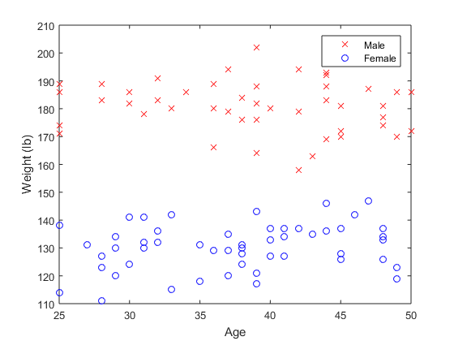
Plotting Data from Tables
Use dot notation to plot data for a whole column:
plot(PatientData.Age, PatientData.Weight, ‘xr’)
Logical indexing can be used to select data to plot. To plot data for just the males in the data set:
ind = strcmp( PatientData.Gender, 'Male');
plot(PatientData.Age(ind), PatientData.Weight(ind), 'xr')
Invert the selection to plot the data for females:
plot(PatientData.Age(~ind), PatientData.Weight(~ind), 'ob')
Notes:
Exercise 11.1 page 48

Slide 103
Importing Data
Import Wizard
Use the Import Data button
or right click on filename and select Import Data…
Data can be imported as row or column vectors where headers are present
Otherwise imported as matrix
Use Import Selection-> Generate Script or Generate Function to create code to reproduce import of the selected data
Also launch using
>> uiimport(‘SimonVega.jpg’)
Notes:
Show import of Section0.txt using wizard
Show save as matrix, renaming variable names, changing type to text
Show cell array for text
Import Section0Columns.txt – imports x and y
Show import of SimonVega.jpg – show 3D array with RGB uiimport(‘SimonVega.jpg’)
show changing colours & plot
>> SimonVega(100:200, 100:200, 1) = 255;

Slide 104
Cleaning Data
Bad or missing data will be imported as NaN
This can be removed using logical indexing
Gives logical vector with value of 1 where data is NaN
badData = isnan(Age);
CleanAge = Age(~badData);
Use ~ (not) so that good data has value of 1 in logical vector
Exercise 12.1, p52
Notes:
Use Age.mat to demonstrate
Exercise 12.1, p52

Slide 105

Face to face Feedback
We really value your feedback, which you can provide by completing this short survey
Course date as 29/04/2025
Course code as GSTML1
Notes:
Finally, thank you for your time and attention in attending today’s course.
Please help us improve by filling in the evaluation form, the QR code is displayed on the screen. You can fill it out now. I will also share the link when I send you the slides after the course.

Slide 106
Toolboxes
Signal Processing
https://uk.mathworks.com/products/signal.html
Image Processing
https://uk.mathworks.com/products/image.html
Optimisation
https://uk.mathworks.com/products/optimization.html
Symbolic Maths
https://uk.mathworks.com/products/symbolic.html
Data Acquisition
https://uk.mathworks.com/products/daq.html
Control System
https://uk.mathworks.com/help/control/index.html
Curve Fitting
https://uk.mathworks.com/products/curvefitting.html
Statistics and Machine Learning
https://uk.mathworks.com/products/statistics.html

Slide 107
More to Explore
Version Control using GIT – keep track of changes to your code
https://uk.mathworks.com/help/matlab/matlab_prog/set-up-git-source-control.html
App Designer – for generating user interfaces
https://uk.mathworks.com/help/matlab/gui-development.html?category=gui-development&s_tid=CRUX_topnav
Profiler – use to find bottlenecks in programs and speed up code
https://uk.mathworks.com/help/matlab/matlab_prog/profiling-for-improving-performance.html
Testing Frameworks – use to set up automated tests for your code
https://uk.mathworks.com/help/matlab/matlab-unit-test-framework.html

Slide 108
Research Software Network Team
Community of researchers from across the university who write code as part of their research.
Either search for Team and join or drop Louise a line to be added

